Slide 1
TITLE : DISASTER MANAGEMENT USING BLOCKCHAIN
PHASE-2 Project Presentation -2019
Under the guidance of
Prof. Chayapathi A R
Department of ISE
Acharya Institute Of Technology
Batch No:- 14
Project Team Members:
Niharika V Jain (1AY15IS056)
Nikhila P (1AY15IS058)
Pavan P Galagali (1AY15IS062)
Pavan Padmanaabha (1AY15IS063)

Slide 2
Agenda
Abstract
Introduction
Problem Statement
Requirement Specification (Hardware and Software)
Design
Implementation (Modules & Functions)
Snapshots (Results)
Testing
Applications
Conclusion
Future Enhancements
References

Slide 3
Abstract
Providing effective rescue operations and disaster management is one of the major ways of reducing the devastating outcomes of the crisis situation.
In spite of countries and non-governmental organizations being swift to react when disaster strikes, humanitarian efforts are often harmed by a lack of transparency between different relief parties.
Blockchain is able to quickly and easily spin up an independent system of record that could be key to providing quicker, more effective help for people affected by an emergency.

Slide 4
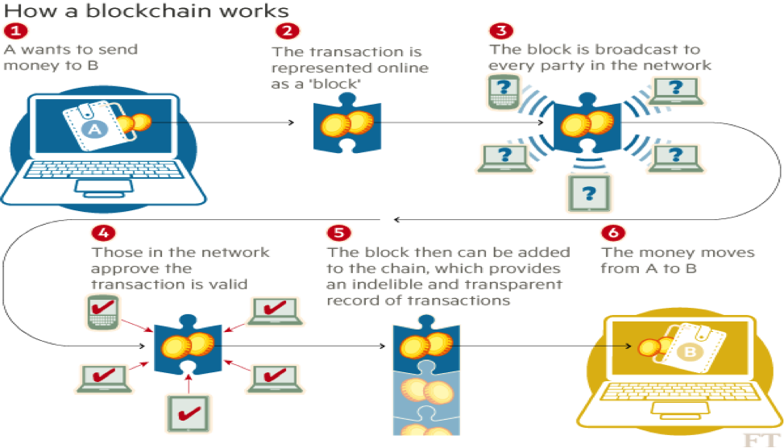
Introduction
Blockchain uses a shared distributed ledger which ensures transactions and data reach all concerned parties as soon as they are created. This leads to early settlements.

Slide 5
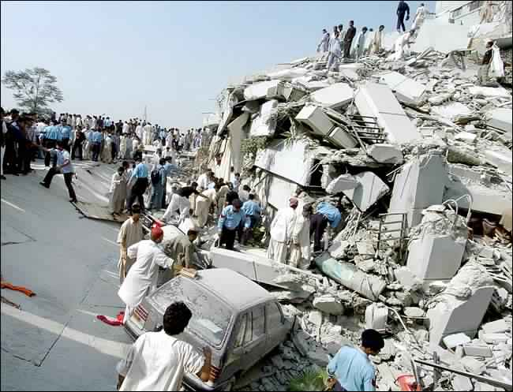
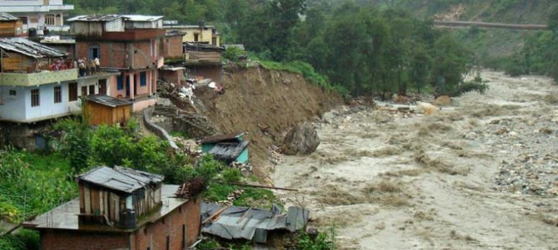
Problem Statement
1. Absence of effective communication for request of resources during unexpected and uncontrolled disasters.
2. Lack of disaster management services.

Slide 6
Requirement Specification (Hardware and Software)
Software requirements :
1. Operating system : Windows
2. EthereumVM: Embark framework( for blocks).
3. Decentralized data storage using IPFS(Interplanetary File System protocol)
4. DApp (The main Ethereum software)
5. Web3js contracts (Smart Contract building for blocks)
Hardware requirements :
1. Workstation.
2. Application specific storage medium.
3. Raspberry pi 3
4. Display Monitor

Slide 7
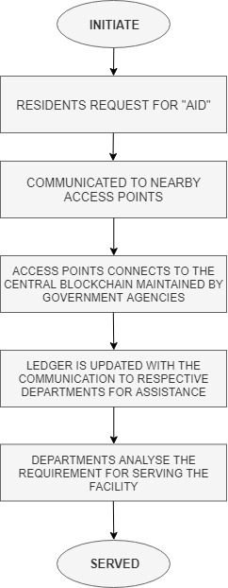
Design (Flow Chart)

Slide 8
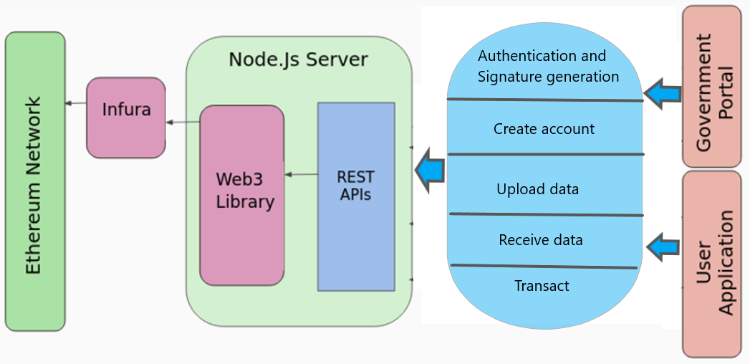
Design (Outline)
Embark

Slide 9
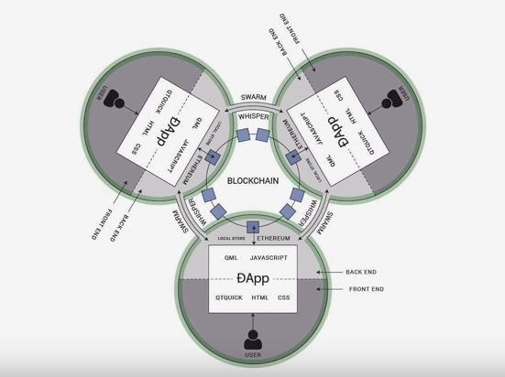
Design (Dapp)

Slide 10
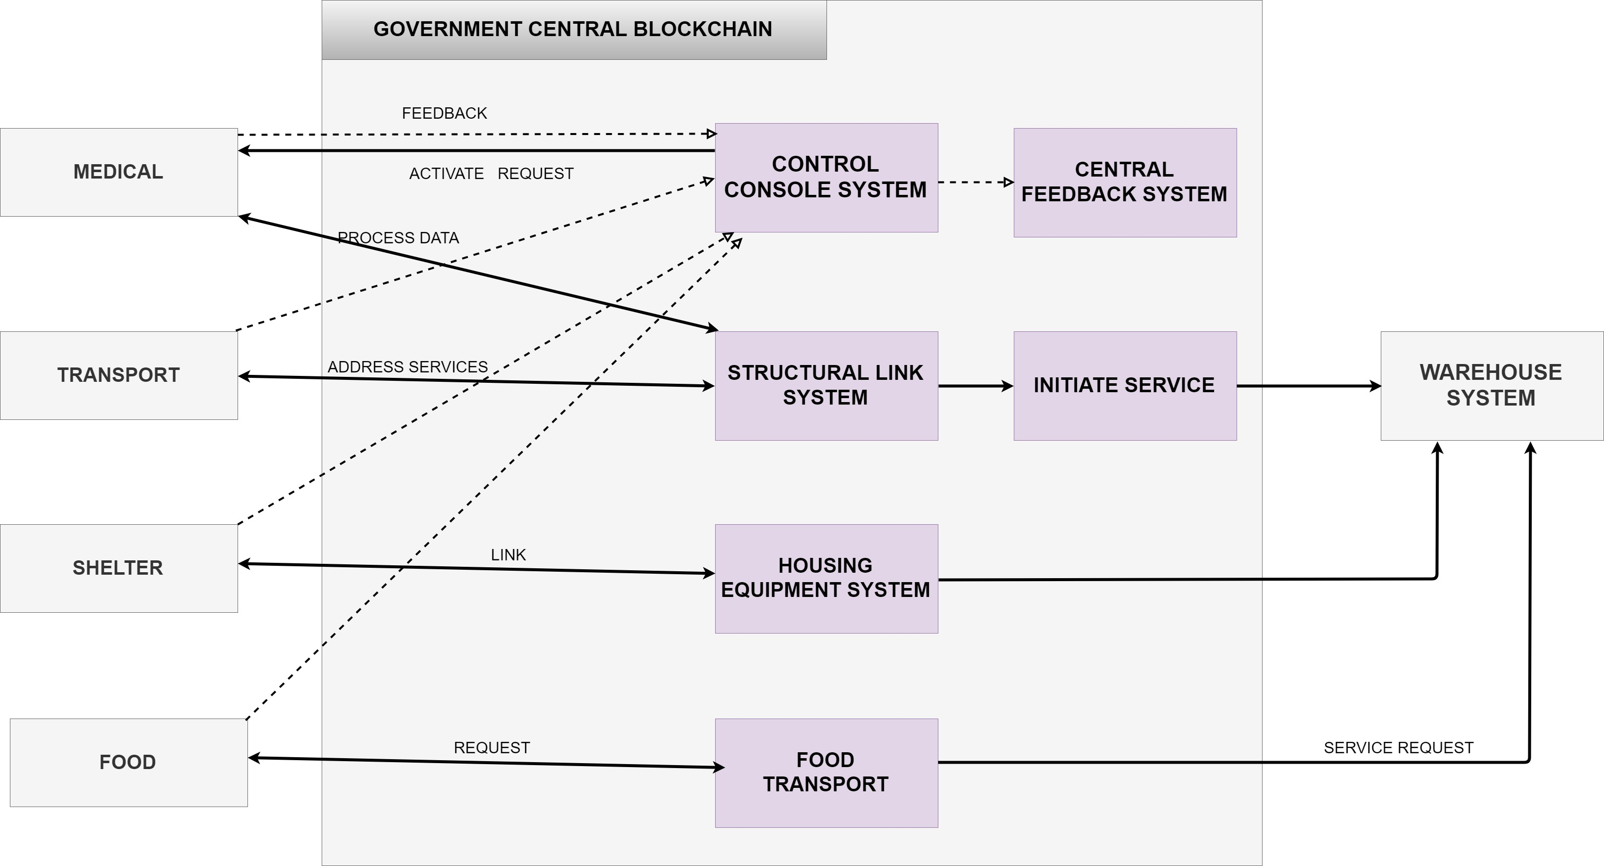
Design (System Diagram)

Slide 11
List of modules Identified.
Participants or Residents (Raspberry pi 3) -> Raspberry pi 3 helps in sending emergency messages between residents and the government portal.
Government Agencies -> Government portal sends the messages to respective departments for respective services.
Uploading files to IPFS -> Option to upload the file to the IPFS cloud to maintain ledger system in a decentralized storage.
Crowd-sourcing for funds( Smart Contracts) -> Smart Contracts are used for fund transfer between various entities.

Slide 12
List of modules Identified.
To get live co-ordinates of disaster hit locations -> View Map function helps in identifying appropriate disaster hit location using latitude and longitude values.
Funds from banks to the government -> Funds can be securely transferred from different banks to various government portals.
Etherscan provided by Ethereum -> Maintains the ledger.
Forecast -> Updates of weather in different cities and information regarding environmental activities.

Slide 13
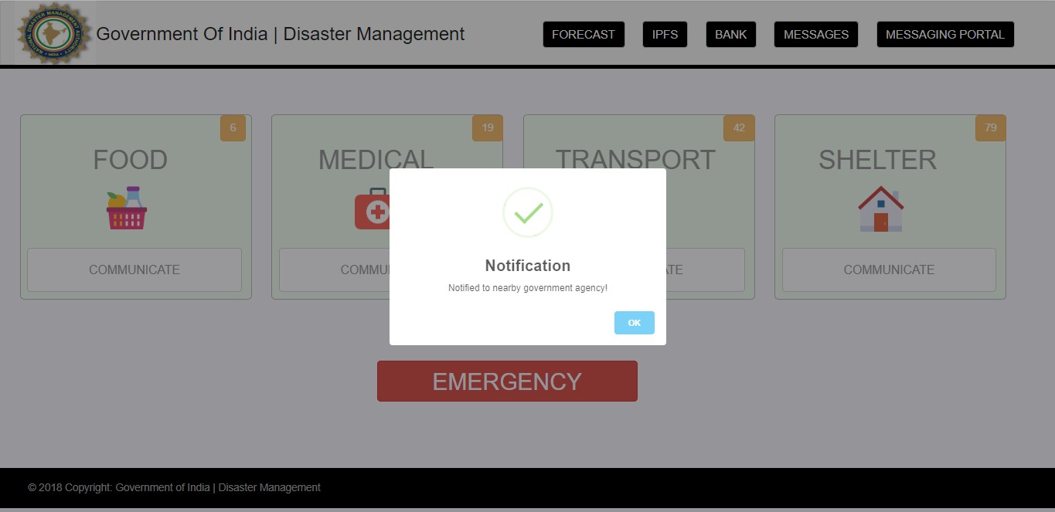
Snapshot -1 (Results)
Emergency alert to nearby portals

Slide 14
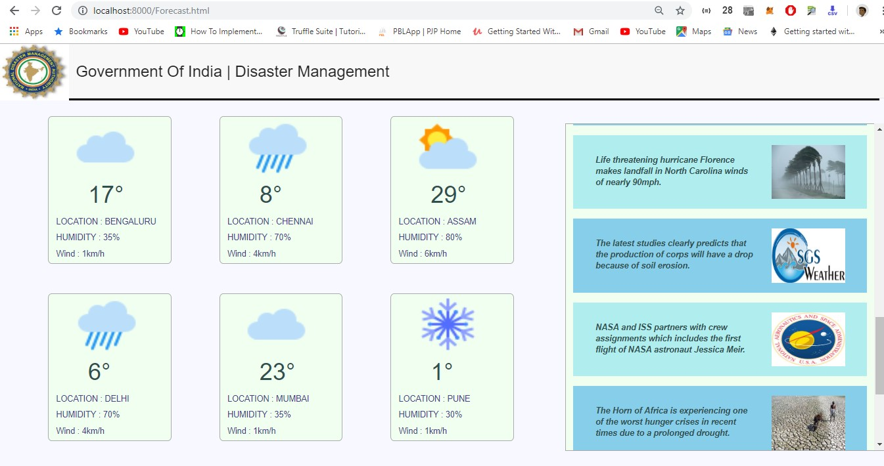
Snapshot -2 (Results)
False weather prediction analysis against real-time report

Slide 15
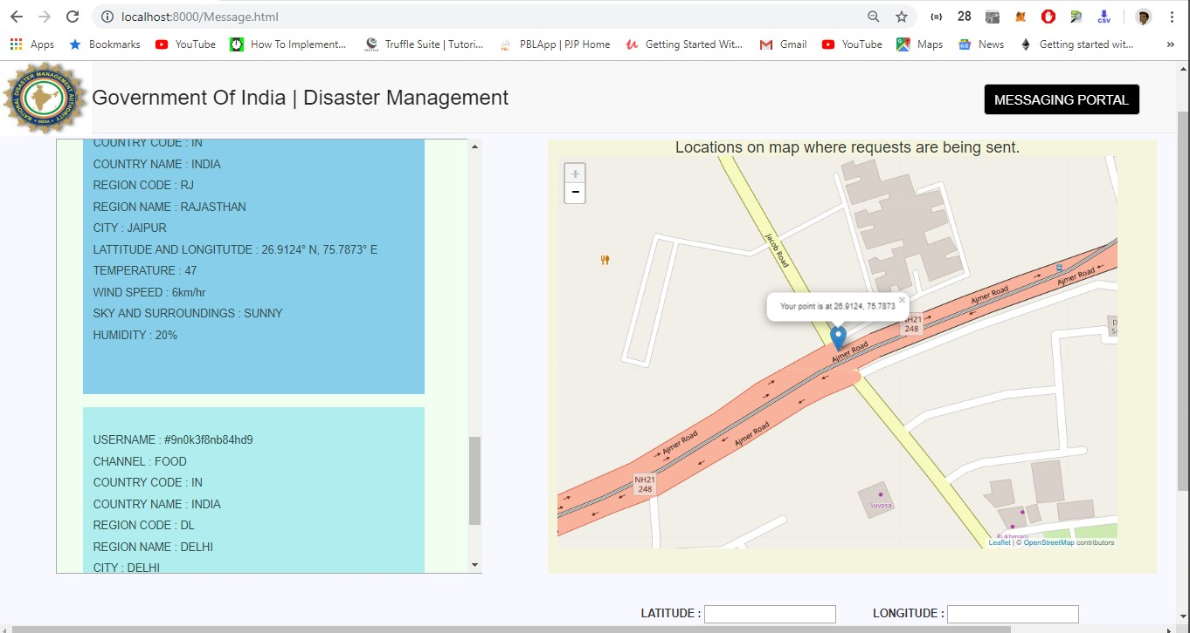
Snapshot -3 (Results)
Messages to government portal from residents

Slide 16
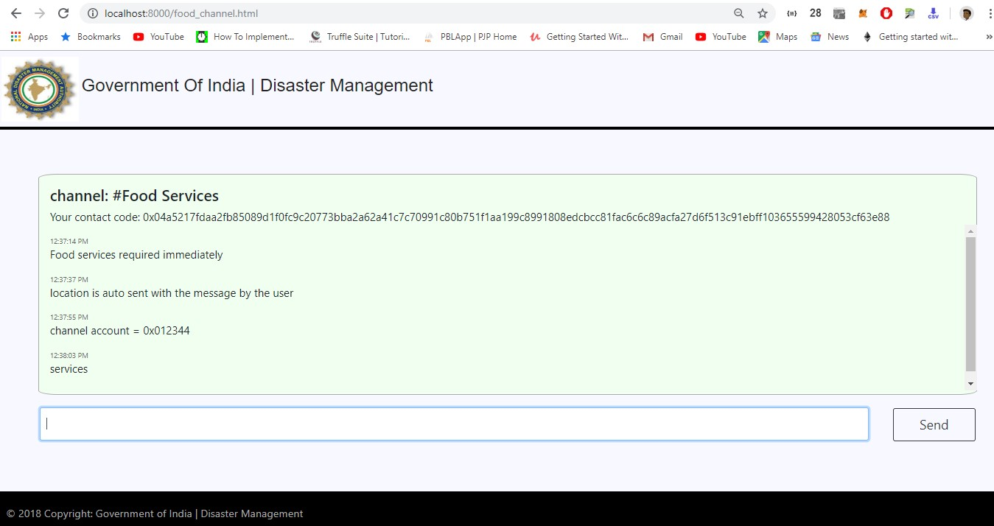
Snapshot -4 (Results)
Food services communication channel

Slide 17
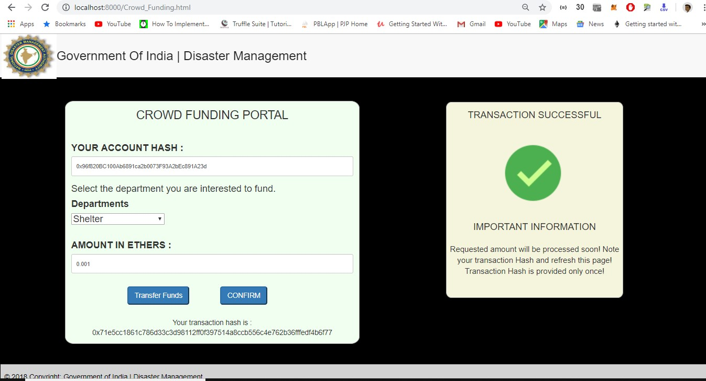
Snapshot -5 (Results)
Crowd-funding portal with successful transaction

Slide 18
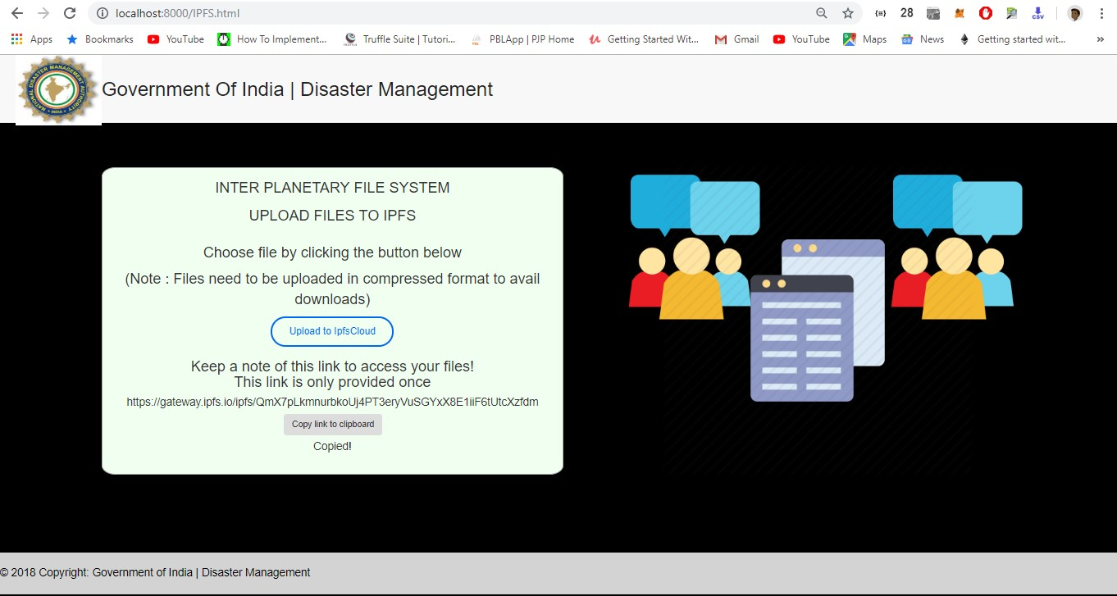
Snapshot -6 (Results)
Uploading of files to IPFS cloud

Slide 19
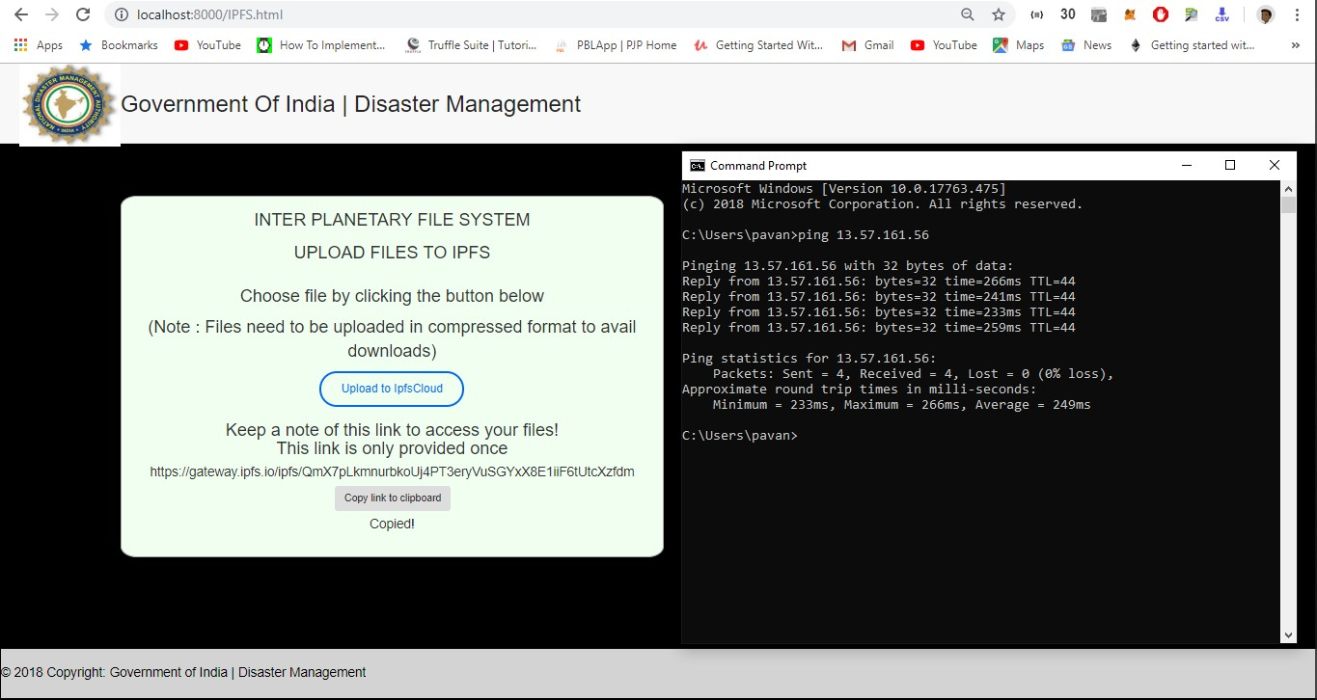
Snapshot -7 (Results)
IPFS with ping statistics

Slide 20
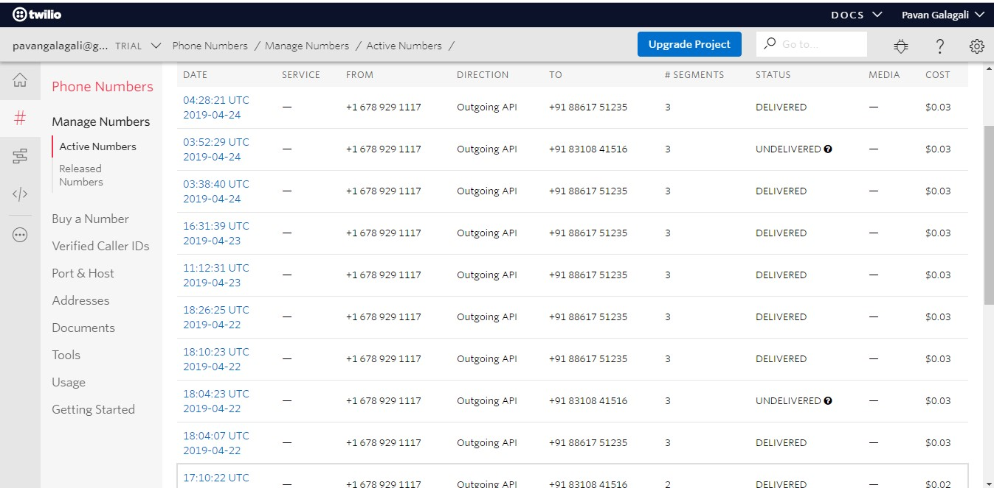
Snapshot -8 (Results)
Twilio API network consistency

Slide 21
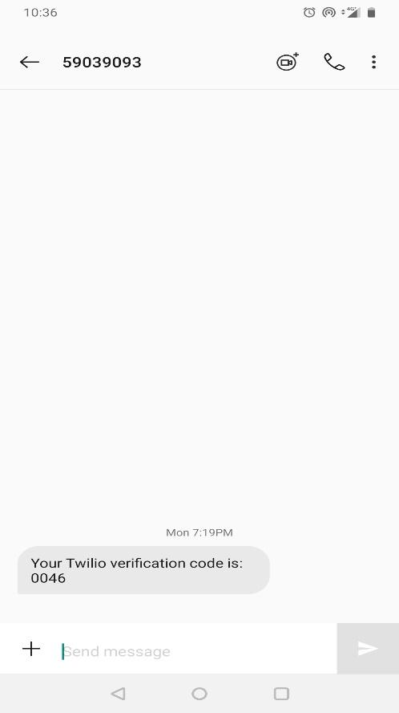
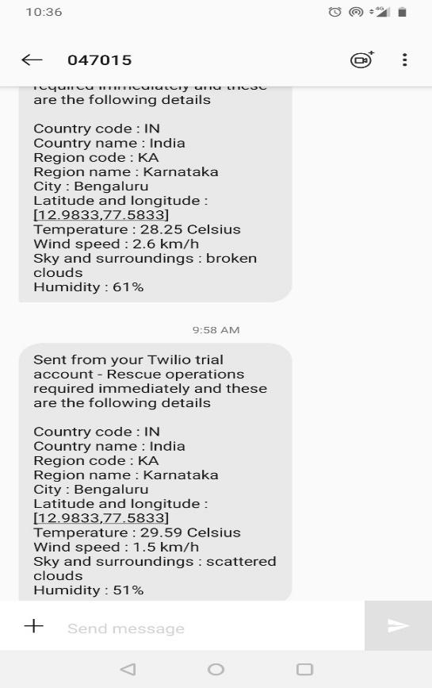
Snapshot -9 (Results)
Message received by the victim hit by disaster through Twilio API

Slide 22
Testing: Unit testing
Test Case ID | Test Scenario | Test Steps | Test data/Fields | Expected Results | Actual Results | Pass/Fail
Unit Testing: White Box Testing
UT01 | Enter Latitude and Longitude values manually to get position | Enter the values | 27.09876, -77.9865 | Position is clearly marked on the map | As expected | Pass
UT02 | Entering negative values to transfer funds (Ether) | Enter the negative value | -0.09845 | Transaction is not initiated | As expected | Pass
UT03 | Default file specified for maintaining ledger | Enter the file name and copy to clip board | Example.txt with content “Hi” | URL of the default file is copied | As expected | Pass
UT04 | Different files uploaded to the IPFS cloud | Upload the file | Example.txt, Ether_trans.txt | successful uploading with unique URL | As expected | Pass

Slide 23
Testing: Unit testing
UT05 | Enter the invalid value for ethers | Enter the value | 90 | “Insufficient funds” | As expected | Pass
UT06 | Choosing department to fund | Department not specified | Default selected as “Select any option” | Transfer of funds failed. | Irregular termination of transaction | Fail
UT07 | Choosing department to fund | Department not specified | Default selected as “Select any option” | Transfer of funds failed. | Alert message was displayed and transaction failed. | Pass
UT08 | Integration of MetaMask application | MetaMask integration | Click on “Confirm” and “Send funds” | Initialization of the application for further fund transfer | As expected | Pass

Slide 24
Testing: Integration testing
Test Case ID | Test Scenario | Test Steps | Test data/Fields | Expected Results | Actual Results | Pass/Fail
Integration Testing : Grey box testing
IT01 | The link of the file uploaded to the clipboard to view the content of the file | Paste the URL | File | Content of the uploaded file is displayed | Content of the uploaded file is displayed | Pass
IT02 | Transaction of Ethers from Bank Portal | Click on "Send Request" button | Input - Ethers specified | Meta Mask Applicaton recieves the Ethers and transfers to the requested channel | Meta Mask Applicaton recieves the Ethers and transfers to the requested channel | Pass
IT03 | Transfer funds to a paticular department in Funding Department Portal | Click on "Transfer Funds" button | Input - Ethers specified | Meta Mask Applicaton recieves the Ethers and transfers to the requested channel | Meta Mask Applicaton recieves the Ethers and transfers to the requested channel | Pass
IT04 | Raspberry Pi fetches Location, Time , Weather parameters and transfers the data to Twilio account | Choose an option to communicate on the Pi Monitor | Input-Option selected by the user | Message sent to phone from Twilio | Message sent to phone from Twilio | Pass

Slide 25
Testing: Integration testing
IT05 | Embark initialization to navigate to the index page | Run Embark on Command Prompt | Input Command - "Embark Run" | Successful navigation to index page | Successful navigation to index page | Pass
IT06 | Government channel sends a message to all the channels connected to it | Click on"Send" button | Input-Message | Successful message transmission to channels | Only the first department received the message. | Fail
IT07 | Government channel sends a message to all the channels connected to it | Click on"Send" button | Input-Message | Successful message transmission to channels | Successful message transmission to channels | Pass
IT08 | Account balance updation after transfer of funds | Click on "Update available balance" | RPC Request to metamask | Government's bank account is updated with the balance | Government's bank account is updated with the balance | Pass
IT09 | Transfer of Ethers with insufficient funds in Government's Bank account | Click on "Send Funds" button | Input- Account credentials | MetaMask Application notifies about insufficient funds | MetaMask Application notifies about insufficient funds | Pass

Slide 26
Testing: System testing
Test Case ID | Test Scenario | Test Steps | Test data/Fields | Expected Results | Actual Results | Pass/Fail
System Testing : Black Box Testing
ST01 | Hardware Testing: Raspberry Pi Interaction with APIs | 1. Collection of Weather Data 2. Collection of Location information 3. Transfer data to Twilio | 1. Weather 2. Location 3. Message | Message sent to the government portal | As expected | Pass
ST02 | MetaMask Application: Testing the maintainance of Distributed Ledger for transactions | 1. Open MetaMask with valid credentials 2. Access Etherscan 3.Provide account details | 1. User Authentication 2. Account ID | Option of downloading ledger in .csv format | As expected | Pass
ST03 | Whisper Protocol: Testing Secured transmission of data though encrypted channel | 1. Access communication channel 2. Compose a message | Messages | Messages diplayed on the corresponding symmetric channel | As expected | Pass

Slide 27
Testing: System testing
ST04 | Twilio System: Testing bidirectional comunication from Raspberry Pi to Portal | 1. Option selected by users from Raspberry Pi 2. Access Government Portal identification 3. Transfer Message to identified government module | Options with relevant parameters | Government Portal recieves the following data: 1. Weather 2.Location 3. Time 4. Option selected by user | As expected | Pass
ST05 | Accessing files through IPFS gateway | 1. Copy the URL provided by the IPFS cloud 2. Place the URL in browser | IPFS File Location Hash | The uploaded files are downloded in zipped format | File could not be downloaded | Fail
ST05 | Accessing files through IPFS gateway | 1. Copy the URL provided by the IPFS cloud 2. Place the URL in browser | IPFS File Location Hash | The uploaded files are downloded in zipped format | As expected | Pass
ST06 | Embark json configuration | 1. Adding dependencies to the file project in json format | Dependencies | Emnark writes the relevent dependencies to blockchain node | As expected | Pass

Slide 28
Applications
1. Banking sector: The funding during the cause of the disasters can be managed with the aid from various banks.
2. Health: The information in regard to people affected during disaster can be sent to nearby hospitals for subsequent treatment.
3. Disaster Management: The mitigation activities needed for the relief of the affected can use this system.

Slide 29
Conclusion
Blockchain allows organizations to facilitate a service and publish on the network using their existing ecosystem.
All the transactions taking place are stored in the network. It provides an immutability feature by offering a secure network where a record once created can't be tampered or deleted.
Since the Blockchain works on a shared distributed ledger system, it ensures that the data and transactions reach the respective parties as soon as they are created.

Slide 30
Future Enhancement
The project can be further enhanced in many perspectives.
The interoperability between Raspberry Pi and Embark can be further optimized.
Introducing variable frequency drive to Raspberry pi.
Currently, the deployment is in Rinkeby Test network, but can be deployed to Ethereum’s main network.

Slide 31
References
31
Blockchain Applications for Disaster Management and National Security. (https://search.proquest.com/openview/29d23a7400378e8b63a45cad2a6eb928/1?pq-origsite=gscholar&cbl=18750&diss=y).
Disaster Management Solution. (https://developer.ibm.com/blockchain/2017/12/09/disaster-management-using-blockchain-iot).
Blockchain technologies. (https://www.coindesk.com/information/what-is-blockchain-technology/)

Slide 32
References
Blockchain (https://en.wikipedia.org/wiki/Blockchain).
Blockchain Disaster Relief –SAP Center. (https://news.sap.com/2017/11/blockchain-disaster-relief/)
IPFS (https://github.com/ipfs/ipfs)
DApps for Blockchain (https://blockchainhub.net/decentralized-applications-dapps/)
Embark Framework (https://github.com/embark-framework/embark)

Slide 33

33

Slide 34

Any Questions ?
34

